Slide 1


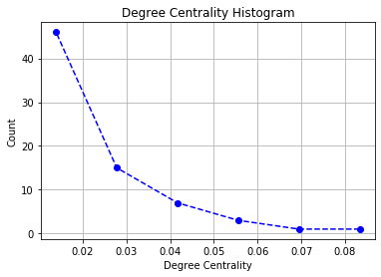
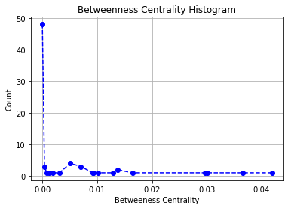
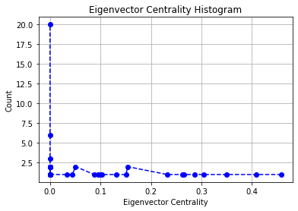
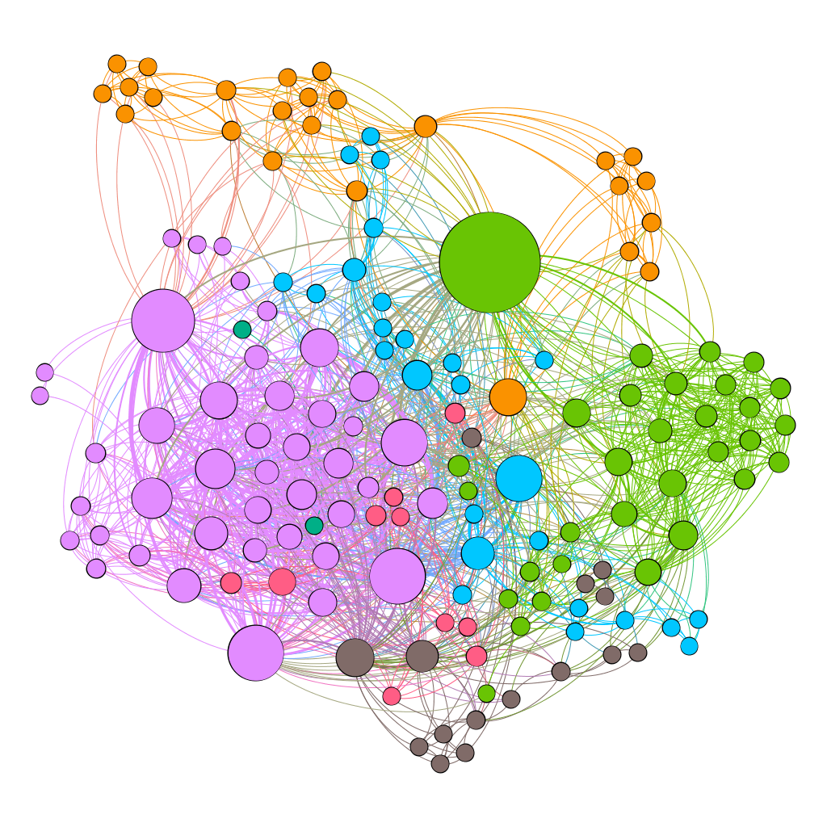
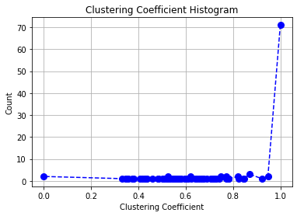
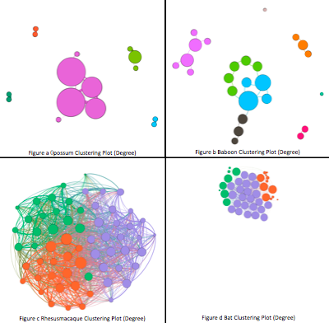
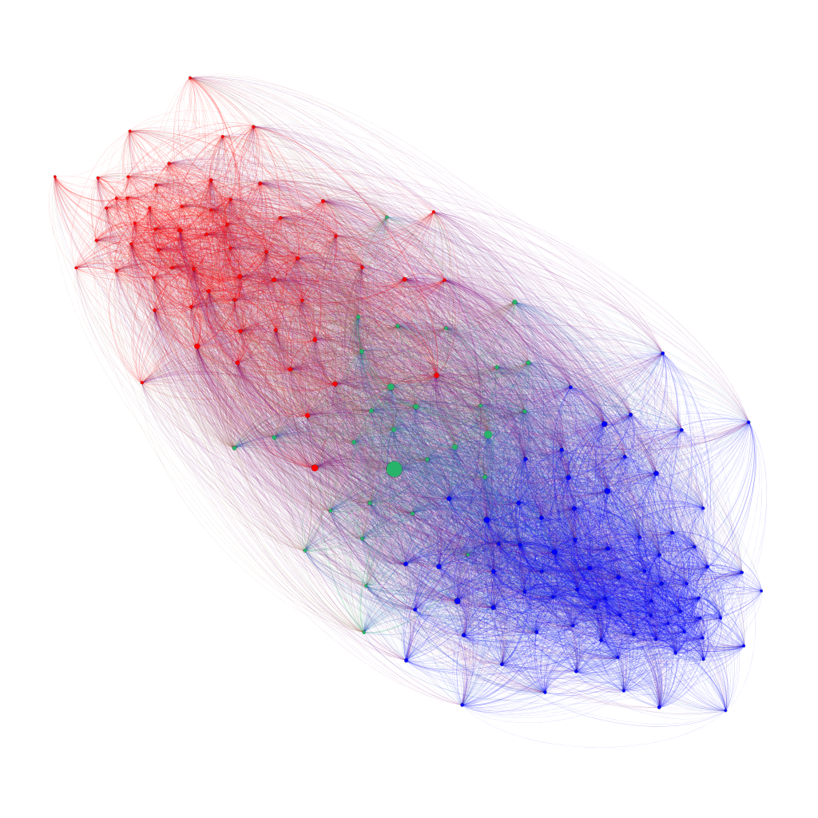
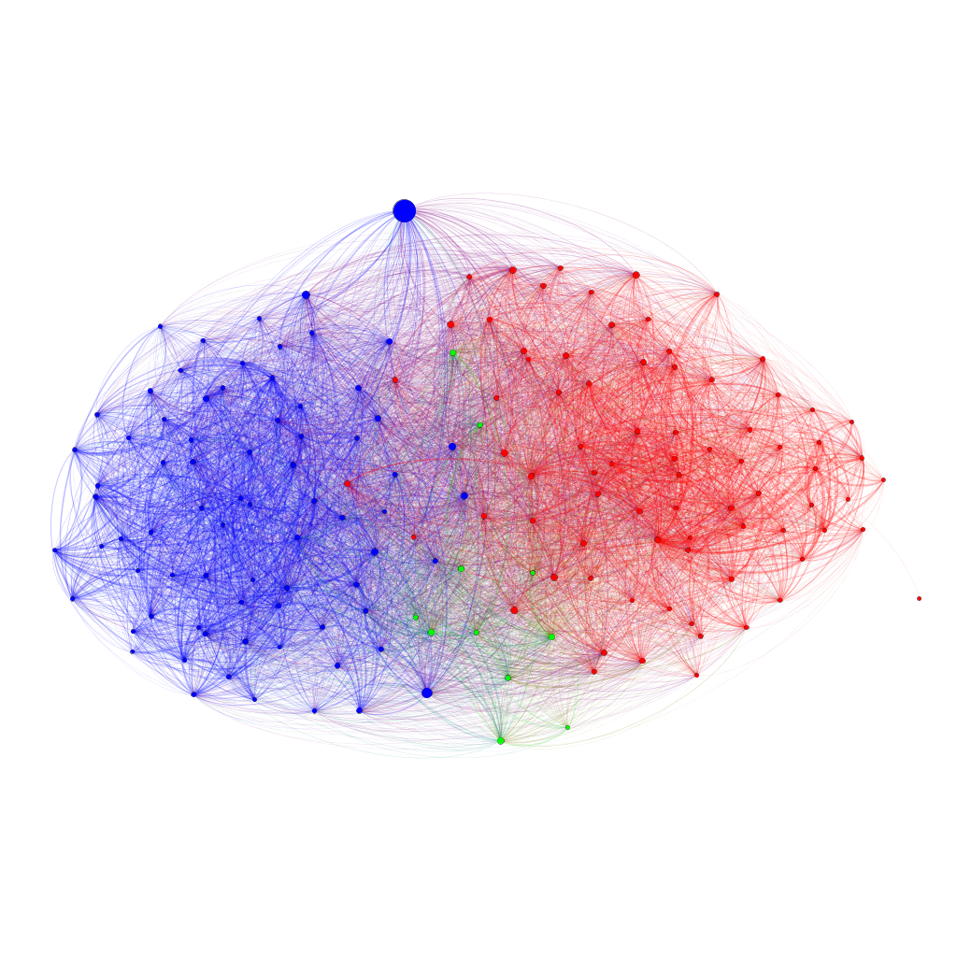
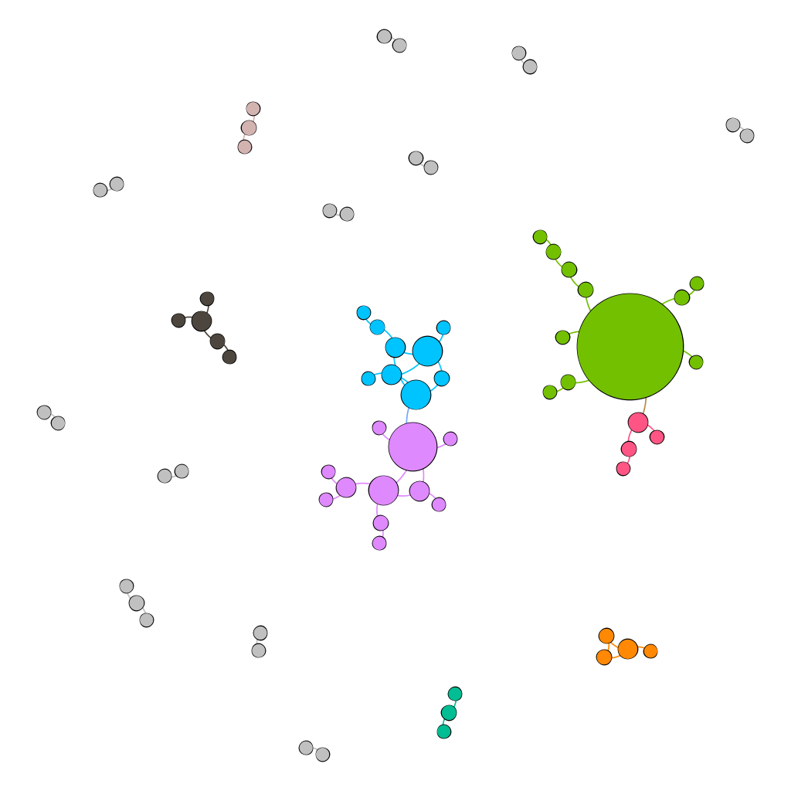
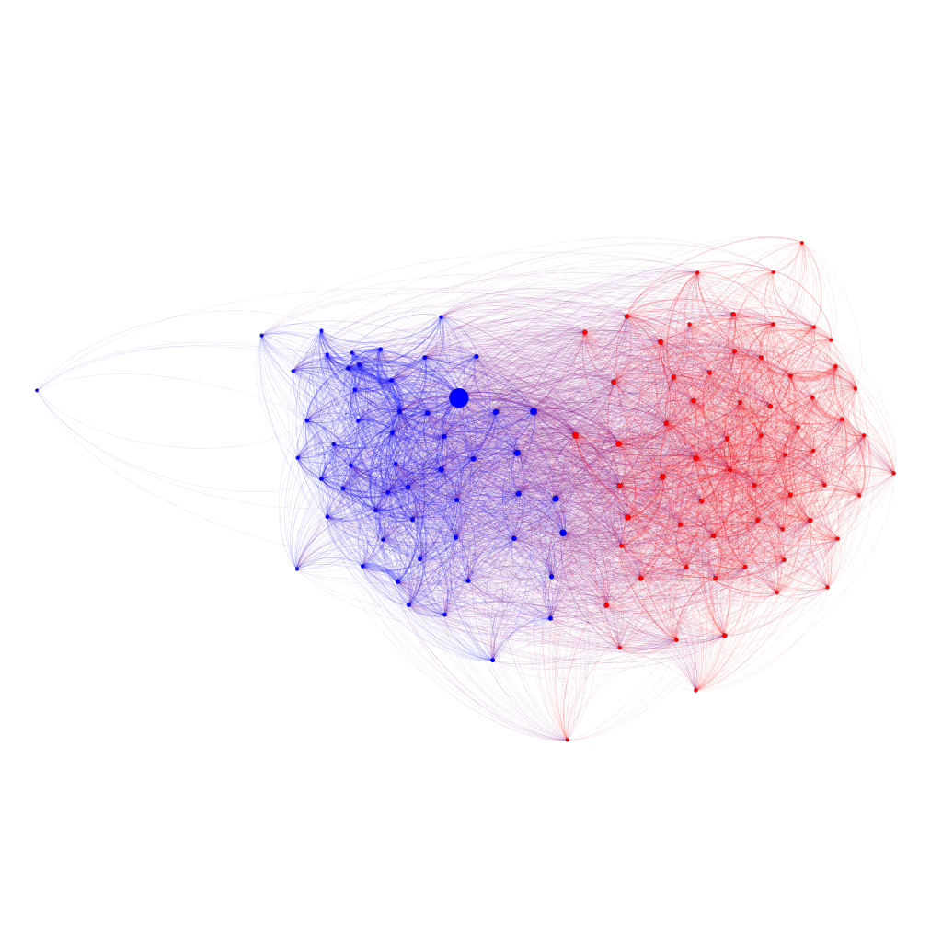
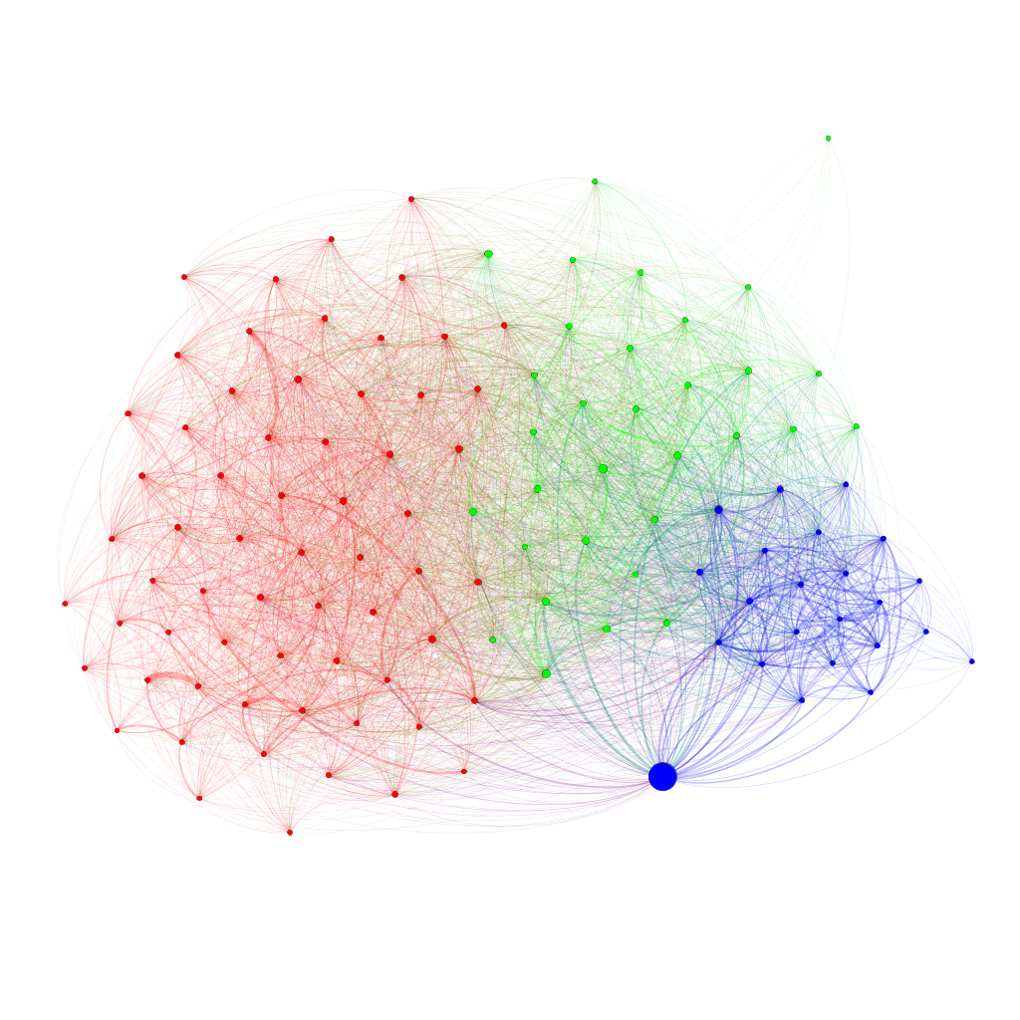
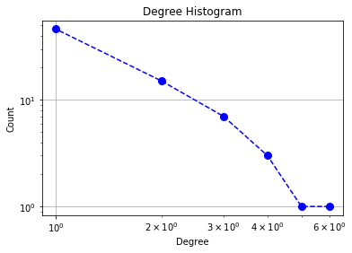

Dive Deep into the World of Animal Social Network
Yeqing Huang, Yudi Wang, Di Gu, and Shuangcheng Yang
Department of Electrical and Computer Engineering, University of California, San Diego
Abstract
they are very close to the visualization result of Facebook network. Elephant community is similar to that of human from this aspect.
Using community detection algorithm, we first investigate whether ants organize themselves into cohesive social groups. By running community detection algorithm on the interaction networks from different time period, we reveal two robust groups to which the same set of ants are affiliated on almost all days. The first group always comprises of the queen and 41 ± 12% of the workers. The second group represents 31 ± 11% of the colony’s workforce.
In Figure[7](c) different from baboons, rhesus macaque network shows they are social animals. Rhesus macaques interact using a variety of social expressions, vocalizations, body postures and gestures. Additionally, the “central male subgroup” contains the two or three oldest and most dominant males which are codominant, along with females, their infants, and juveniles. So they shows compact communication between communities as shown in the Figure[7](c).
In Figure[7](d), some bats lead solitary lives, while others live in colonies of more than a million. Living in large colonies lessens the risk to an individual of predation. They are apparently social mammals. At the same time, bats are among the most vocal of mammals and produce calls to attract mates, find roost partners and defend resources. So they can generate good contact between communities.
Social network analysis is an invaluable tool to understand the patterns of animal community. Most animals are social animals, but their ways of interaction are quite different. This project aim to visualize and explore various interaction patterns among different social animal species. We first focus on analyzing specific social animals’ behavior pattern: Asian elephant, dolphin, and Ants. Other typical social networks are also investigated to obtain a more comprehensive view of the problem. After combining the network science as well as animal behavior biology knowledge, we manage to offer some interesting explanations to those visualization results.
Through visual analysis, we also observe that the ants affiliated with the two robust groups on only a few days may form a third group with less marked within-group preferential interactions.
Figure 3. Asian elephant network degree, betweenness and eigenvector centrality histogram
In summary, these results indicate that the colony is structured in three interconnected social groups and these groups differ in their interaction patterns.
Introduction
Dolphin Network Analysis
Data analysis based on network science is a core technique for studying real world data. The purpose of this project is to implement network theory with its representation and graph theory elements on the animal social networks. Both theoretical and empirical analysis are performed when exploring the structure and dynamics of such networks.
For dataset, we adopt the Animal Social Network Repository (ASNR) offered by Nature. This repository offers more than 650 social networks from 47 species, including those of mammal, reptiles, fish, birds, and insects. We mainly explore the data repository by three ways:
Figure out the network size, calculate and compare the diameter as well as the average shortest path among different species.
For the most famous social animal like dolphin, ants and Asian elephant, draw histogram and the network pattern, and use the animal social behavior biology to explain those visualization results.
Using the community detection algorithm to figure out the relationship between different species and the number of detected communities.
Dolphin is a well-known highly intelligent creature. Here, we take bottlenose dolphin as target, since they are highly social animals and often have preferential associations. These associations are expressed by their physical contact and synchronous movements. The social network data we analyzed are collected on the behavioral states of 147 resident bottlenose dolphins in Cedar Key over two different periods, 2008 and 2010 and such network indicates the preferential associations among individuals as we move forward.
Based on the behavior analysis finished by Daniel P. Mersch, we call these three groups nurses, foragers and cleaners, respectively.
Nurses interact the most with the queens and frequently visits the brood; Foragers perform most of the foraging trips, while cleaners exhibit a significantly higher propensity to visit the rubbish pile.
 | Nurses | Foragers | Cleaners
Day 1 | 45.73% | 35.98% | 18.29%
Day 11 | 45.73% | 47.56% | 6.71%
Day 21 | 45.76% | 54.24% | -
Day 31 | 19.49% | 53.39% | 27.12%
Conclusion
For social networks, we have shown that network analysis successfully captures important characteristic social structure and behavior of bottlenose dolphins. Individuals generally maintain a high level of association, and the community structure determined by the social network is expected as their social nature.
It can be concluded that graph theory and network theory are powerful tools with high potential. Degree distribution, clustering coefficient and community detection are useful to extract the behavior information related to the network.
Table 2. Ratio of three ant groups at different timestamps
Community detection analysis also reveals that ants exhibit a preferred behavioral trajectory, moving from nursing to cleaning to foraging as they age.
Pattern Comparison
Further Exploration
Figure[7](a) The opossum is a marsupial of the order Didelphimorphia endemic to the Americas. Their unspecialized biology, flexible diet, and reproductive habits make them successful colonizers and survivors in diverse locations and conditions. As shown in the graph, it has several independent clustering and each of them maintains compact community. However, they aren’t assuming to be social animals. At the same time, there is no much communication between each opossum clustering.
Collecting sexes, age and other information about a population. This could help extend the use of our network science tool to other behavioral study for species.
Observing over a large time span, since only a long-time observation can lead to a conclusion on certain behavior.
Base on given dataset, collect animals that belong to a same family but evolve in different environments like African elephant compared to Asian elephant.
Figure 4. Dolphin network graph
Species | Diameter | Average Shortest Path
Asian Elephant | 7 | 3.447368
Dolphin | 4 | 2.175132
Ant | 3 | 1.356194
Baboon | 3 | 1.718
Opossum | 3 | 1.429
Rhesus Macaque | 2 | 1.383
Bat | 4 | 1.472868
For the network graph, there are some elements worth noticing. The average degree of the graph is around 20.5828, which is high and proposes that the individual in the group have strong and repeated connection to many other individuals.
The clustering coefficient plot (Figure[5]) proves that dolphins are highly connected because most individuals have a clustering coefficient of 1. Namely, dolphins that are connected to a particular dolphin are more likely to be connected to each other. They engage in strong and frequent associations when socializing.
Acknowledgement
Table 1. Fundamental graph elements for different networks
Big thanks to Professor Massimo and his TAs
We would also like to thank UCSD for the Datahub infrastructure.
It appears that no obvious conclusion can be drawn from Table 1 since very little information is conveyed by the numbers. Below we take a closer look into seven typical social animals and do analysis from various aspects.
Figure 5. Dolphin network clustering coefficient histogram
References
Asian Elephant Network Analysis
Ant Network Analysis
Sah, P., Méndez, J.D. & Bansal, S. (2019). A multi-species repository of social networks. Sci Data 6, 44 doi:10.1038/s41597-019-0056-z
Gazda, S., S. Iyer, T. Killingback, R. Connor and S. Brault. (2015). The importance of delineating networks by activity type in bottlenose dolphins (Tursiops truncatus) in Cedar Key, Florida. Royal Society Open Science 2:140263.
de Silva, S., Schmid, V., & Wittemyer, G. (2016). Fission–fusion processes weaken dominance networks of female Asian elephants in a productive habitat. Behavioral Ecology, 28, 243–252.
Mersch, D.P., Crespi, A. & Keller, L. (2013). Tracking individuals shows spatial fidelity is a key regulator of ant social organization. Science, 340, 1090–1093.
Southwick, C., Beg, M., and R. Siddiqi (1965) "Rhesus Monkeys in North India." Primate Behavior: Field Studies of monkeys and apes. DeVore, I. San Francisco: Holt, Rinehart and Winston.
Bergman TJ, Beehner JC, Cheney DL, Seyfarth RM (2003). "Hierarchical classification by rank and kinship in baboons". Science. 302 (November 14): 1234–1236. doi:10.1126/science.1087513. PMID 14615544.
Fenton, M. B. (2001). Bats. Checkmark Books.
Jones, G. (2001). "Bats". In MacDonald, D. (ed.). The Encyclopedia of Mammals (2nd ed.). Oxford University Press. pp. 754–775. ISBN 978-0-7607-1969-5.
Elephants are well-known for their intelligence, close family ties and social complexity. They live in a fluid fission-fusion society with relationships radiating out from the mother-offspring bond through families, bond groups, clans, independent males and beyond to strangers.
This characteristic can be clearly observed from Figure[1]. This network contains several small grey node pairs, which are very likely to be the temporary male members in this community. They only contact with limited community members due to the need of mating. Meantime, there exists one predominant green point which should be the eldest female leader.
(a)
(b)
Figure 1. Asian elephant network graph
Figure 7. Network graphs for Opossum, Baboon, Rhesus macaque and Bat
Another interesting finding for the Asian Elephant network is its degree histogram (Figure[2]), which almost perfectly obeys the power law distribution. This proved that the elephant society is highly developed and all the behavior of each member is dependent on others.
Figure[7](b) the collective noun for baboons is “troop”. Most baboons live in hierarchical troops. Group sizes vary between five and 250 animals depending on specific circumstances, especially species and time of year. The hamadryas baboons often appear in very large groups composed of many smaller harems (one male with four or more females). Meanwhile, males will raid harems for females. Such situations often cause aggressive fights between the males. We can conclude that each clustering has limited community communication.
(c)
Figure 6. Ant network graphs
(d)
Figure 2. Asian elephant network degree histogram
Ant colony network analysis at
(a) day 1, (b) day 11, (c) day 21, (d) day 31
Different node color refer to:
Red: Foragers
Blue: Nurses
Green: Cleaners
Finally, when we look into the centrality of the nodes of the graph, we can find

